Slide 1

#LifeKoKaroLift
Linear Regression Kickstart Session

Slide 2
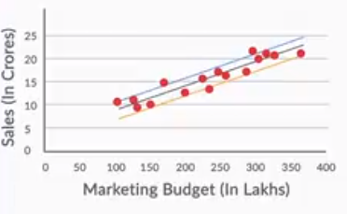
SLR
Best Fit Line

Slide 3
SLR

Slide 4
SLR

Slide 5
SLR

Slide 6
SLR

